Slide 1

OPTIMIZATION FINAL PROJECT
Providing a solution for NetLife’s Cashflow Requirements
© Created by Asef Wafa
December 2016

Slide 2
PRESENTATION AGENDA
Business Situation
Issues Facing The Decisions
Formulation Constraints
Formulation Steps
Approach to Solutions
Additional Considerations
Recommended Strategy
PRESENTATION AGENDA 2

Slide 3

BUSINESS SITUATION
Netlife is an insurance company looking to meet the following goals:
1.
COVER LIFE INSURANCE POLICY PAYOUTS
Purchase loan bundles to cover 15 year insurance policy payouts
2.
ATTEMPT TO MINIMIZE CASH ON HAND
Balancing the tradeoff between having an adequate number of bundles and too much cash on hand at the end of 15 years.
3.
SYNCHRONIZE CASH FLOWS WITH PAYOUTS
Spending the least amount of money in order to buy the best set of loan bundles that will successfully service their life insurance requirements while maintaining an adequate cash buffer each year.
BUSINESS SITUATION 3

Slide 4



ISSUES FACING THE DECISION
Each investment comes with the risk of unpredictable cashflows
- Weighing the risk levels of each investment
Purchasing the right amount of bundles to cover volatility
- Too many bundles lead to too much cash on hand
Penalty of not being able to pay off policy payouts
- Leads to a loan with 10% interest rate
ISSUES W/ DECISION 4

Slide 5
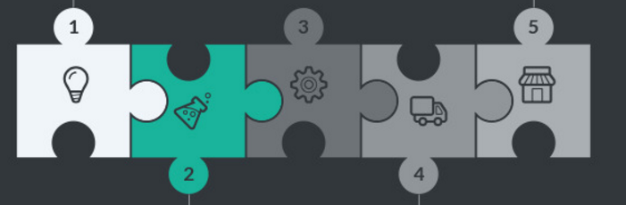
FORMULATION CONSTRAINTS
Do not allow cash flow to be negative at the end of each year
Cash flow received in year 0 is used as a cash buffer
Include surplus cashflow rolling over to next year’s cash flow
Cash surpluses receive 1.5% return each year
Cash balance in the beginning is 0
FORMULATION CONSTRAINTS 5
Notes:
in our evaluation, the two constraints we used were: do not allow the cash flow to become negative at the end of each year i.e. no deficits and cash inflow from bundles > cash payouts;

Slide 6


FORMULATION STEPS
BEST CASE SCENARIO ASSUMPTIONS
WORST CASE SCENARIO ASSUMPTIONS
Deals w/ bundles paying maximum cash flow each year.
Deals w/ bundles paying minimum cash flow each year.
The cost of all bundles included are near the true minimum.
The cost of all bundles included are near the true maximum.
STEPS TO OUR RECOMMENDED SOLUTION
Transform Netlife’s cash flow dilemma into a mathematical problem
Create a formulation to approach this problem
Pick appropriate constraints to reflect Netlife’s cash requirements
Evaluate best and worst case scenario
Find the set of bundles that fit our constraints and service the best and worst case scenarios
Run many simulations on the bundles to find the pattern for most frequently occurring loan bundles
For each simulation, we used a normal distribution for cash requirements and cash payouts for each year
The last step involves grouping bundles based on how much money a manager would want to spend on the bundles. The more money a manager is willing to spend the more options he has to mitigate risk
The most frequently occurring loan bundle is a flexible recommendation that fits multiple scenarios with varying cash flows
FORMULATION STEPS 6

Slide 7
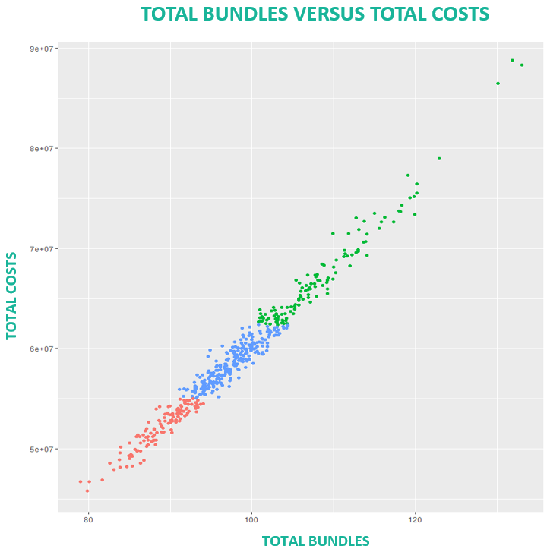
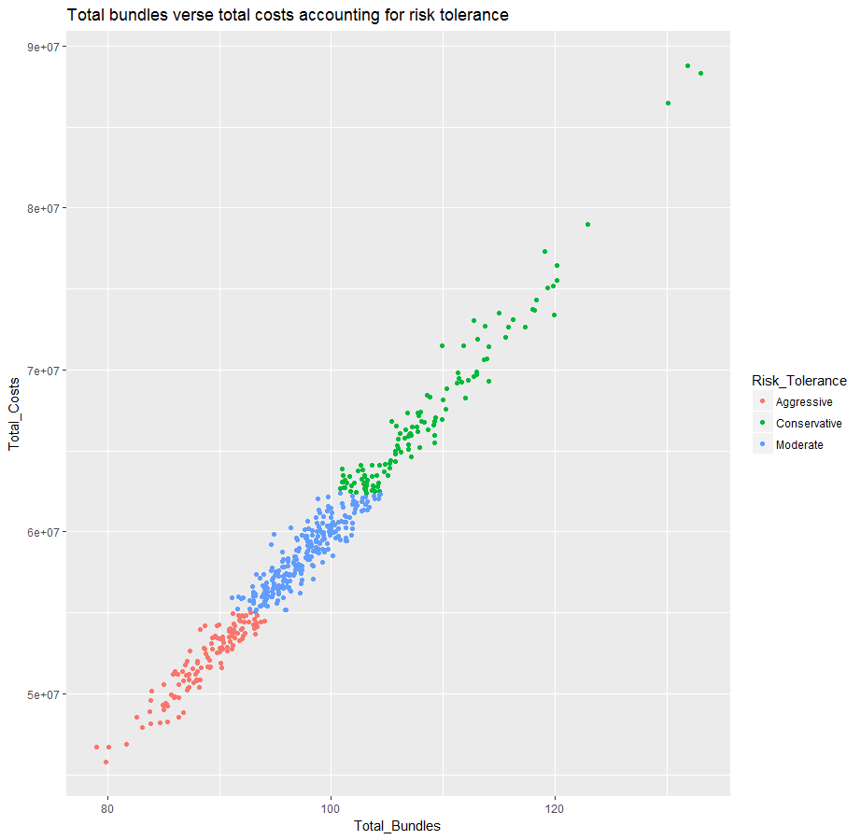
APPROACH TO SOLUTIONS
COSTS VERSUS RISK TOLERANCE
Aggressive: Total Costs < 1st Quantile
Moderate: 1st Quantile < Total Costs < 3st Quantile
Conservative: Total Costs > 3st Quantile
Cash
Risk
APPROACH TO SOLUTIONS 7
Notes:
in our evaluation, the two constraints we used were: do not allow the cash flow to become negative at the end of each year i.e. no deficits and cash inflow from bundles > cash payouts;

Slide 8
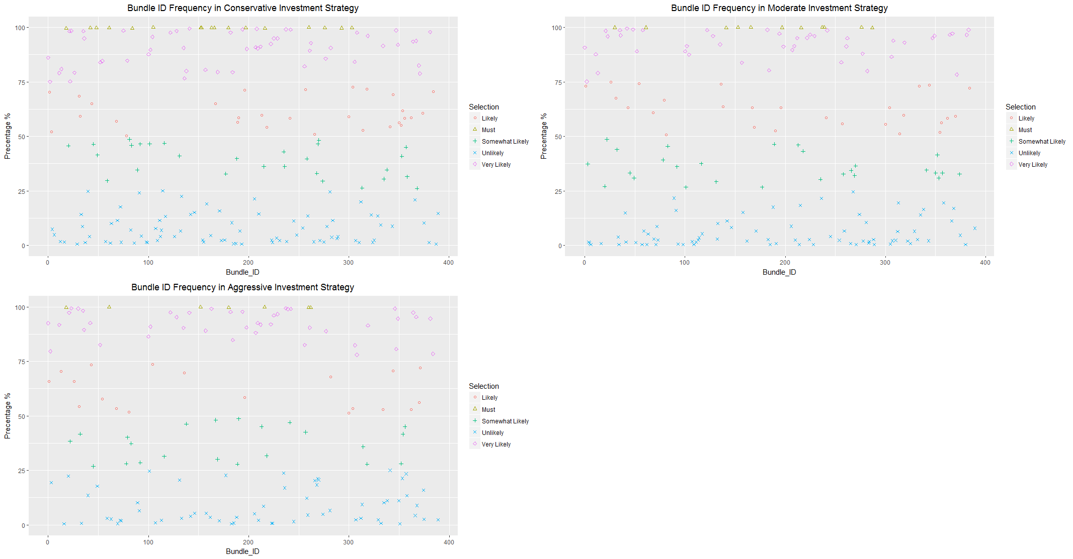
APPROACH TO SOLUTIONS
BUNDLE ID FREQUENCY IN CONSERVATIVE STRATEGY
BUNDLE ID FREQUENCY IN MODERATE STRATEGY
BUNDLE ID FREQUENCY IN AGGRESSIVE STRATEGY
SELECTION
SELECTION
SELECTION
FREQUENCY %
BUNDLE ID
BUNDLE ID
BUNDLE ID
Investment Strategy | Total Simulations | Total Unique Bundles | Average Investment | Bundles with 100% | Bundles over 80%
Aggressive | 125 | 169 | 52.07 | 23 | 65
Moderate | 250 | 200 | 58.57 | 25 | 68
Conservative | 125 | 217 | 67.23 | 25 | 71
APPROACH TO SOLUTIONS 8
Notes:
in our evaluation, the two constraints we used were: do not allow the cash flow to become negative at the end of each year i.e. no deficits and cash inflow from bundles > cash payouts;

Slide 9
APPROACH TO SOLUTIONS
OPTIMAL VALUES
Cash expenditure and number of bundles in our best and worst case scenarios
BEST CASE: 80 bundles
$45,791,803
WORST CASE: 132 bundles
$88,782,908
APPROACH TO SOLUTIONS 9

Slide 10

ADDITIONAL CONSIDERATIONS
RISK TOLERANCE
Different companies/ managers may value different metrics: cash on hand/ risk level/ investment cost.
- We addressed this by presenting multiple solutions.
VOLATILITY
Volatility is likely to occur, thus Netlife cannot be certain of what each year’s cash flows will be. - Peaks and valleys also occur over the years.
ADDITIONAL CONSIDERATION 10

Slide 11
RECOMMENDED STRATEGY
HOW WE CAME TO THE SOLUTION
The simulation used the expected values as the mean, and used a normal distribution to simulate different scenarios.
It then selected the proper bundle combinations to pay off the total policy payouts for each year.
ASSUMPTIONS IN OUR MODEL
Focus on a set of bundles that meet our cash requirements while minimizing purchase price rather than worry about return (IRR)
Cash payouts are required at the end of each year
STRATEGY: IT DEPENDS
Instead of giving Netlife 1 solution, we gave them a model to pick the bundles that are most suited to the level of risk they opt for and amount of money they are willing to spend.
Pick the bundles that occur most frequently based on these considerations.
RECOMMENDED STRATEGY 11
Notes:
Based on our findings we would recommend to a business to pick the bundles that occurred most frequently during our simulation according to the level of risk they opt for and amount of money they are willing to spend.
The simulation used the expected values as the mean, and ultimately selected the proper bundle combinations to pay off the total policy payouts for each year.

Slide 12
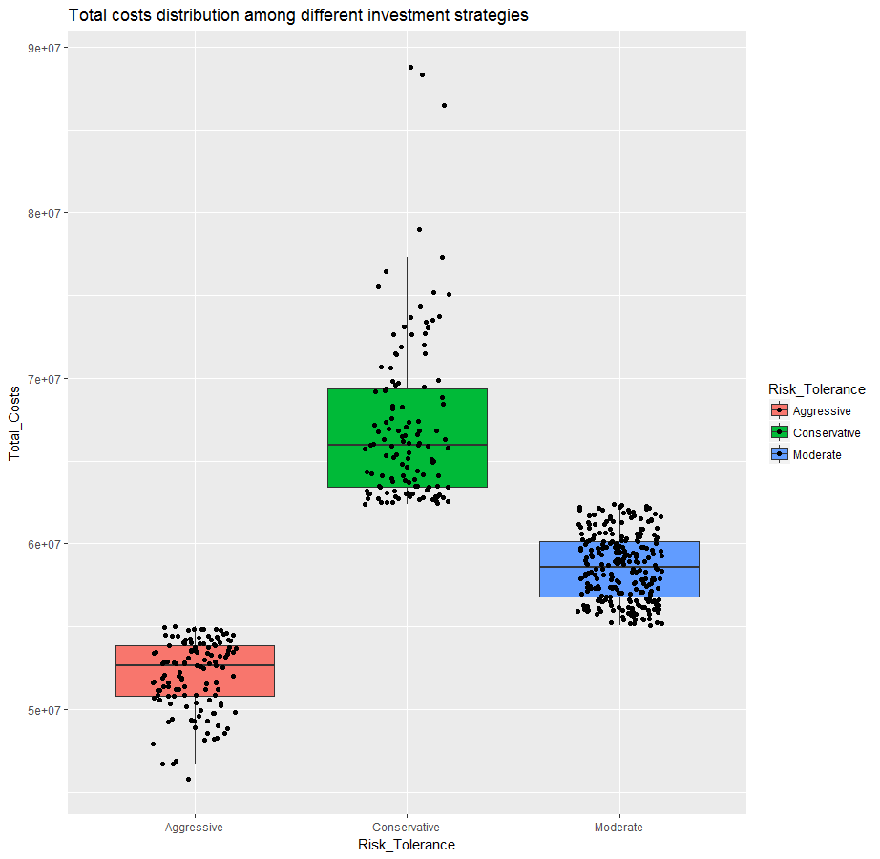
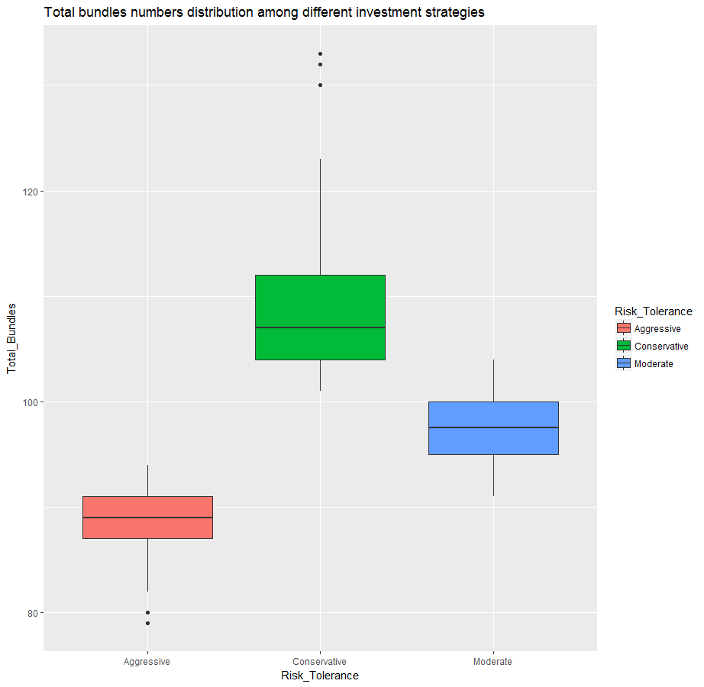
RECOMMENDED STRATEGY
TOTAL COST DISTRIBUTION
TOTAL NUMBER OF BUNDLES DISTRIBUTION
RISK TOLERANCE
RISK TOLERANCE
TOTAL COSTS
TOTAL COSTS
RISK TOLERANCE
RISK TOLERANCE
RECOMMENDED STRATEGY 12
Notes:
Based on our findings we would recommend to a business to pick the bundles that occurred most frequently during our simulation according to the level of risk they opt for and amount of money they are willing to spend.
The simulation used the expected values as the mean, and ultimately selected the proper bundle combinations to pay off the total policy payouts for each year.

Slide 13
RECOMMENDED STRATEGY
EXAMPLE STRATEGY
Pick number of bundles based on risk tolerance
Note: first 55 bundles show up in over 90% of the scenarios
Best case scenario of 80 bundles
1. Just pick the top 80 bundles
2. Notice that the set of bundles show up in over 50% of the scenarios
RECOMMENDED STRATEGY 13
Notes:
Based on our findings we would recommend to a business to pick the bundles that occurred most frequently during our simulation according to the level of risk they opt for and amount of money they are willing to spend.
The simulation used the expected values as the mean, and ultimately selected the proper bundle combinations to pay off the total policy payouts for each year.

Slide 14
THANK YOU, QUESTIONS?
ANY QUESTIONS? 14
Notes:
Based on our findings we would recommend to a business to pick the bundles that occurred most frequently during our simulation according to the level of risk they opt for and amount of money they are willing to spend.
The simulation used the expected values as the mean, and ultimately selected the proper bundle combinations to pay off the total policy payouts for each year.

